Slide 1
Control Flow Statements (Part 2)

Slide 2


Today's Learning Objectives
Gain a comprehensive understanding of iterative statements: for, while, and do-while loops.
Recognize the significance of iterative statements in controlling program flow and repetition.
Practice implementing loops to perform repetitive tasks efficiently.
Explore loop control structures such as break and continue to manipulate loop behavior.
Apply learned techniques to solve real-world problems through practical coding tasks.

Slide 3
Introduction to Iterative Statements

Slide 4

Introduction to Iterative Statements
Imagine you're tasked with going to the grocery store and picking up items from a shopping list. You have a list of items to buy, including fruits, vegetables, dairy products, and snacks. How would you complete this task?

Slide 5
Introduction to Iterative Statements
Would you:
Try to remember all the items on the list at once and gather them in one go,
or
Look at one item on the list, find it in the store, pick it up, then move on to the next item, repeating the process until you've collected everything on your list?

Slide 6
Introduction to Iterative Statements
Iterative statements, also known as loops, are fundamental programming constructs that enable the repetition of a block of code until a specified condition is met.
They play a pivotal role in controlling program flow and automating repetitive tasks.
Iterative statements allow programmers to execute the same code multiple times, iterating over a sequence of values or performing actions based on changing conditions.

Slide 7

Pop Quiz
You are designing an inventory management system for a retail store where employees can update product quantities and prices. Which control flow statement would be most effective in processing the inventory updates efficiently?
If-else statements
Switch-case statements
Nested if-else statements
Loop statements

Slide 8
Pop Quiz
You are designing an inventory management system for a retail store where employees can update product quantities and prices. Which control flow statement would be most effective in processing the inventory updates efficiently?
If-else statements
Switch-case statements
Nested if-else statements
Loop statements
Notes:
Explanation: Loop statements, such as for loops or while loops, are suitable for iterating through multiple inventory updates and processing them systematically, ensuring efficient management of the retail store's inventory.

Slide 9
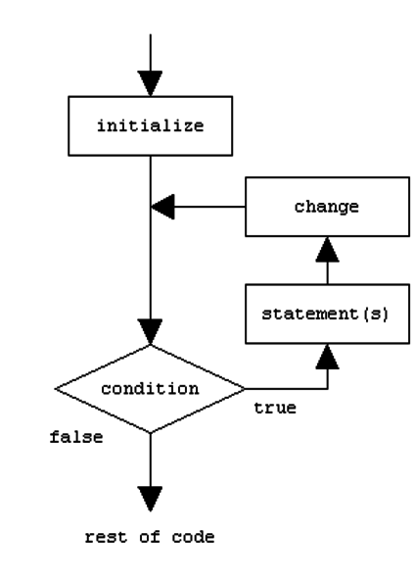
For Loop
A for loop is used to iterate over a range of values or elements in a sequence.
It consists of three parts: initialization, condition, and update.
The initialization initializes the loop control variable, the condition determines whether the loop should continue executing, and the update modifies the loop control variable.

Slide 10

For Loop

Slide 11
For Loop
Write a program to print the first 10 natural numbers.

Slide 12
For Loop
Solution file here.

Slide 13
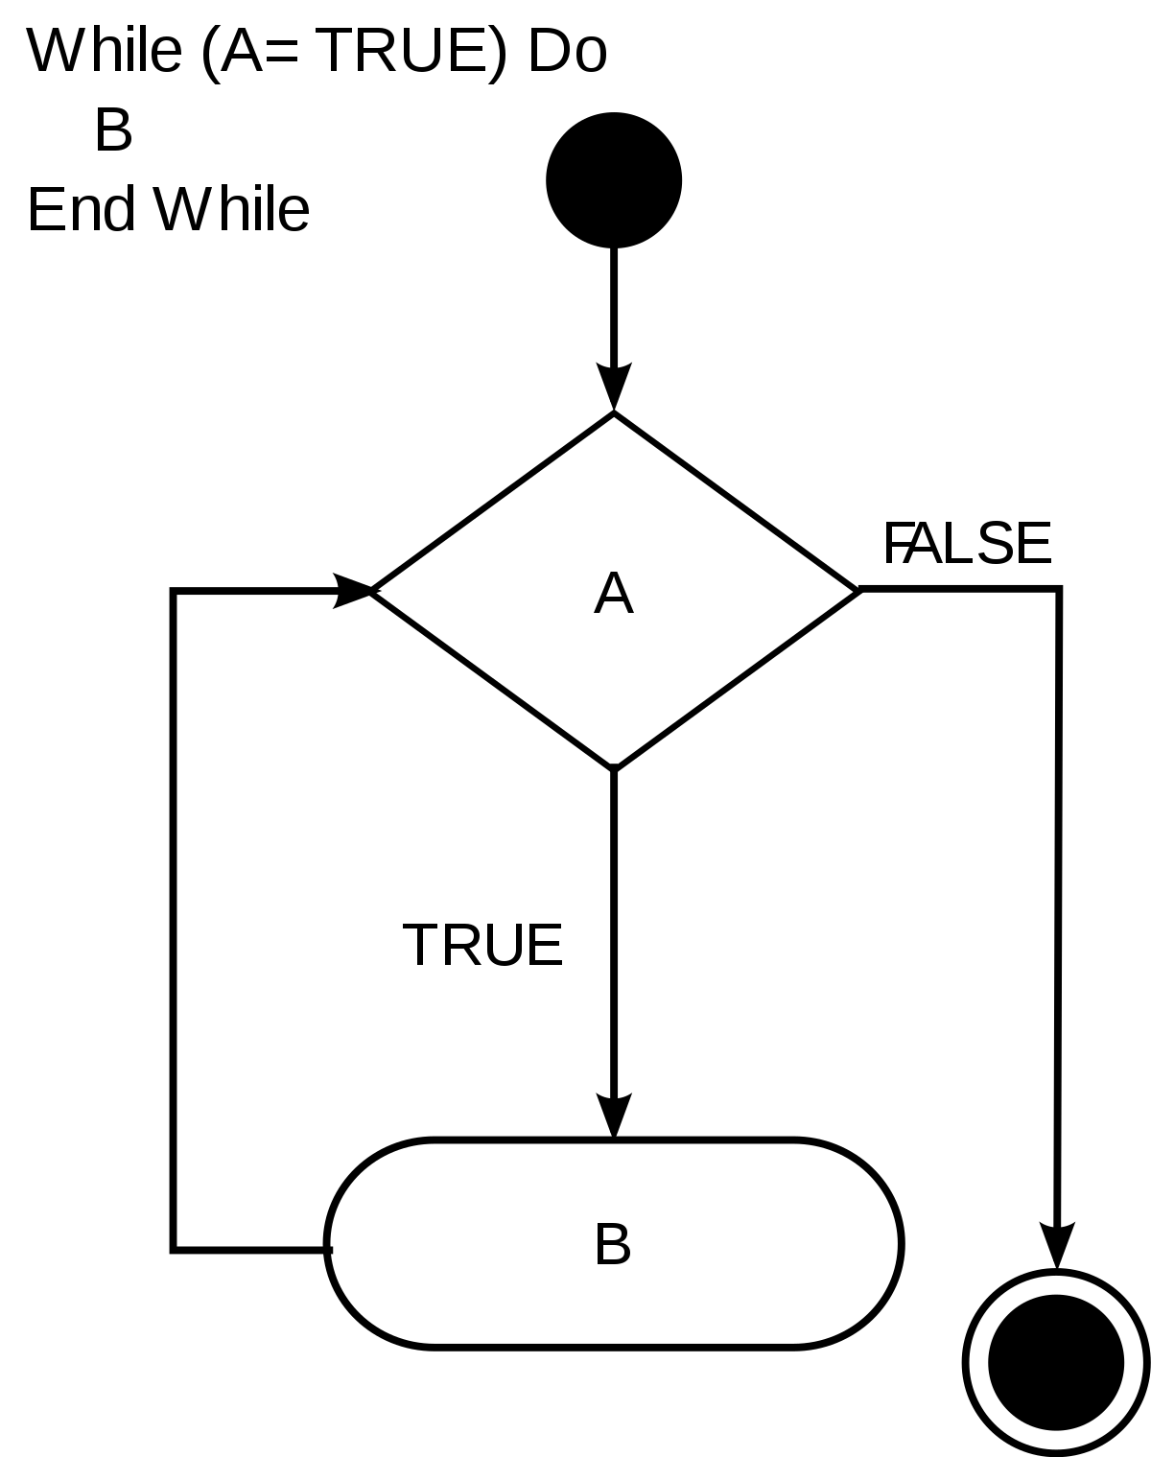
While Loop
A while loop executes a block of code repeatedly as long as a specified condition is true.
It checks the condition before each iteration.
If the condition evaluates to true, the loop continues; otherwise, it terminates.

Slide 14

While Loop

Slide 15
While Loop
Write a program to find the factorial of a given number.

Slide 16
While Loop
Solution file here.

Slide 17
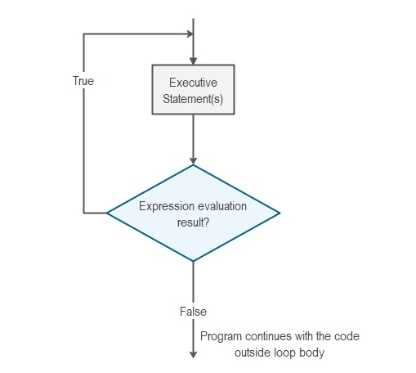
Do-While Loop
A do-while loop executes a block of code at least once, and then repeats as long as a specified condition is true.
It checks the condition after each iteration, so the code block is guaranteed to execute at least once.

Slide 18

Do-While Loop

Slide 19
Do-While Loop
Write a program to display the multiplication table of a given number.

Slide 20
Do-While Loop
Solution file here.

Slide 21
Pop Quiz
Which loop statement in Java is used when the number of iterations is known beforehand and is typically used for iterating over arrays?
for loop
while loop
do-while loop
switch-case

Slide 22
Pop Quiz
Which loop statement in Java is used when the number of iterations is known beforehand and is typically used for iterating over arrays?
for loop
while loop
do-while loop
switch-case

Slide 23
Pop Quiz
Which loop statement in Java is used when you want to execute a block of code repeatedly as long as a condition is true?
for loop
while loop
do-while loop
switch-case

Slide 24
Pop Quiz
Which loop statement in Java is used when you want to execute a block of code repeatedly as long as a condition is true?
for loop
while loop
do-while loop
switch-case

Slide 25
Branching Statements
Branching statements provide flexibility and efficiency in controlling program flow.
They are commonly used to optimize loops, handle special cases, and control the flow of execution within methods.

Slide 26
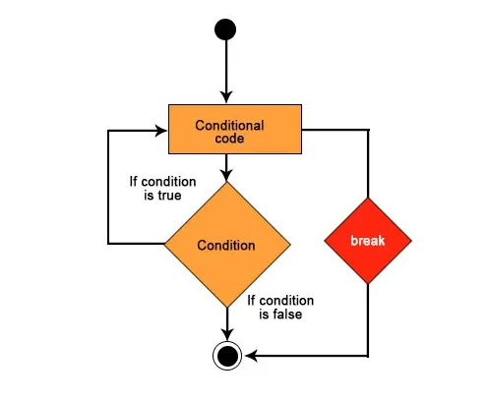
Break Statement
Used to terminate the innermost loop or switch statement and transfer control to the statement immediately following the loop or switch.
Allows for early exit from loops or switch cases.

Slide 27
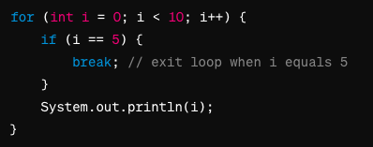
Break Statement

Slide 28
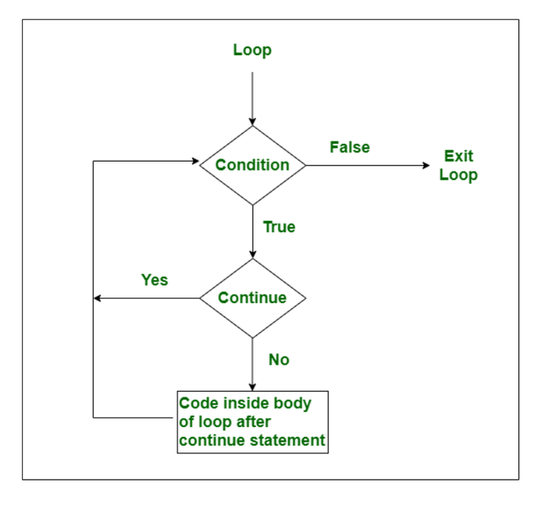
Continue Statement
Skips the current iteration of a loop and proceeds to the next iteration.
Allows for skipping specific iterations based on certain conditions.

Slide 29
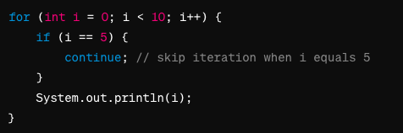
Continue Statement

Slide 30
Branching Statements
Write a Java program to print all even numbers and exit loop if multiple of 5 is encountered.

Slide 31
Do-While Loop
Solution file here.

Slide 32
Pop Quiz
What is the primary purpose of using break statements within a switch-case statement in Java?
To terminate the program execution
To skip the current iteration of a loop
To exit the switch-case statement and prevent fall-through to subsequent cases
To continue to the next case in the switch-case statement

Slide 33
Pop Quiz
What is the primary purpose of using break statements within a switch-case statement in Java?
To terminate the program execution
To skip the current iteration of a loop
To exit the switch-case statement and prevent fall-through to subsequent cases
To continue to the next case in the switch-case statement

Slide 34
Problem Solving

Slide 35
Problem Solving
Write a Java program to reverse a given integer number.

Slide 36
Problem Solving
Solution file here.

Slide 37
Problem Solving
Check the given year is leap year or not.

Slide 38
Problem Solving
Solution file here.

Slide 39
Problem Solving
Print Fibonacci Series

Slide 40
Problem Solving
Solution file here.

Slide 41
Summary
We discussed the importance of loops in programming and their role in repeating a block of code multiple times.
Introduced three main types of loops in Java: for, while, and do-while.
Discussed how to initialize, condition, and update loop variables.
Demonstrated various applications of the for loop in solving problems.
Discussed scenarios where while loops are more suitable.
Emphasized that do-while loops always execute at least once, unlike while loops.
Explained how break terminates the loop and continue skips the current iteration.
Demonstrated practical scenarios where these control statements are useful.
Solved coding problems on these topics

Slide 42



Slide 43
Thank You
Copyright © Upgrad., All rights reserved
Confidential Information, intended for approved distribution list of Upgrad

